Slide 1
C4E Metrics
<customer_name>
20xx-xx-xx

Slide 2
Benefits of Establishing a C4E
The C4E is tasked with enabling business divisions to build and drive the consumption of assets successfully, thereby enabling project delivery speed and agility.
Some of the expected benefits of building a C4E include:
Shorter delivery cycles, including faster time to market for your integration projects through reuse and self-service.
Reduced project risk and on-time delivery of integration projects.
Better adherence to standards and best practices.
Higher quality deliverables as a result of being built on existing templates and APIs, thereby reducing the number of defects and error rates.

Slide 3
Tracking the Value of a C4E
In order to fully realize the benefits of a C4E, key performance indicators (KPIs) should be developed to ensure that the C4E is providing value to the organization.
C4E KPIs are developed with customer input and should align with the customer's C4E vision.
The KPIs should be measured periodically (ideally weekly) and should be regularly revised to ensure relevancy and alignment to business objectives.
The Anypoint Platform and Exchange provide a variety of metrics that can be utilized when constructing these KPIs.

Slide 4
Tracking the Value of a C4E
C4E Metrics can be broken down into the following areas:
Asset Reuse
Helps to track shorter delivery lifecycles and the development of higher quality deliverables.
Asset Availability & Satisfaction
Helps to track the quality and suitability of the integrations, APIs and assets.
Evangelism
Helps to ensure that best practices and standards are being followed.
Employee Onboarding
Helps track employee productivity and can deliver high quality applications.
Governance
Helps ensure that best practices are being followed.

Slide 5
Anypoint Platform Metrics
Each metric is defined using the following criteria:
Name
The name of the metric.
Description
A description of what the metric is capturing.
Calculation
How the metric is calculated.
Format
How the metric is represented.
Source
The data source from which the metric is collected.

Slide 6
Asset Reuse
C4E Metrics

Slide 7
C4E Metrics - Asset Reuse
Asset Reuse Metrics are a critical component when evaluating the overall success of a C4E.
Asset Reuse directly contributes to cost savings.
Reduction in development hours during project delivery.
Reduction of the number of applications managed by Operations staff.
Potential Asset Reuse Metrics
API Reuse Percentage.
Percentage of active APIs that have more than one consumer.
API Average Number of Consumers.
Average number of consumers per API type (Experience, Process, System).
Template Usage.
Number of APIs and integrations using reusable common service templates.
Number of reusable APIs developed or consumed by business group.
Number of active APIs that have more than one consumer developed by or consumed by each business group.

Slide 8
Asset Reuse
C4E Metrics Examples

Slide 9
API Reuse Percentage
Planned vs. Actual

Slide 10
API Reuse Percentage
Planned vs. Actual
Description: This metic displays both the percentage of active APIs that have more than one consumer for the current month and the percentage of what was planned for reuse over the different API types.
Name | Description/Calculation | Format | Source
% Reuse of Experience APIs Planned | The expected percentage of Experience APIs that have 2 or more consumers (application contracts). | Percentage | Leadership Expectation
% Reuse of Experience APIs Actual | The actual percentage of Experience APIs that have 2 or more consumers (application contracts). | Percentage | Anypoint Platform APIs
% Reuse of Process APIs Planned | The expected percentage of Process APIs that have 2 or more consumers (application contracts). | Percentage | Leadership Expectation
% Reuse of Process APIs Actual | The actual percentage of Process APIs that have 2 or more consumers (application contracts). | Percentage | Anypoint Platform APIs
% Reuse of System APIs Planned | The expected percentage of System APIs that have 2 or more consumers (application contracts). | Percentage | Leadership Expectation
% Reuse of System APIs Actual | The actual percentage of System APIs that have 2 or more consumers (application contracts). | Percentage | Anypoint Platform APIs
Notes:
Experience API
API whose name contains “experience-api” in the Production environment.
Process API
API whose name contains “process-api” in the Production environment.
System API
API whose name contains “system-api” in the Production environment.

Slide 11
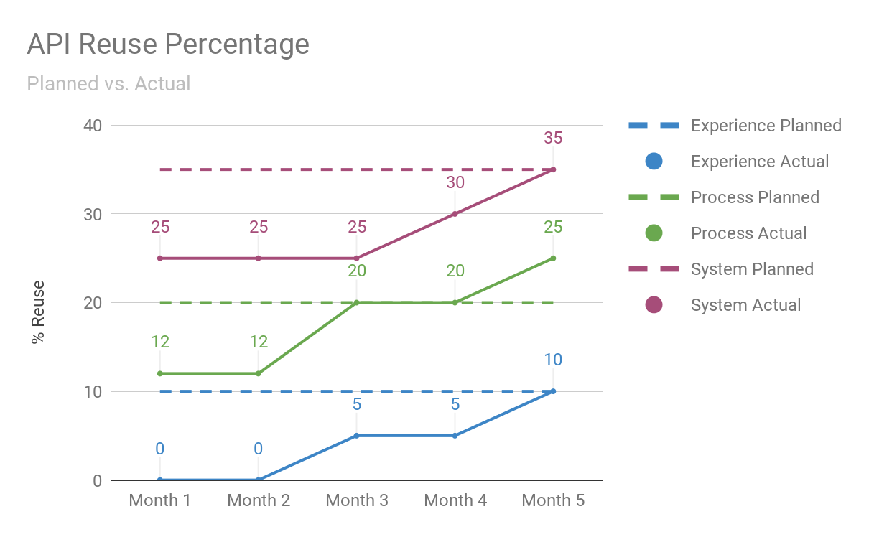
API Reuse Percentage
Planned vs. Actual

Slide 12
Average Number of Consumers
Planned vs. Actual

Slide 13
Average Number of Consumers
Planned vs. Actual
Description: This metric displays the average number of consumers per API type. This metric is a predictor of reuse adoption across the enterprise.
Name | Description/Calculation | Format | Source
Average Number of Consumers (A#C) | Average number of consumers for APIs of each type. | Decimal | Anypoint Platform APIs
A#C for Experience APIs Planned | The expected Average Number of Consumers for Experience APIs. | Decimal | Leadership Expectation
A#C for Experience APIs Actual | The actual Average Number of Consumers for Experience APIs. | Decimal | Anypoint Platform APIs
A#C for Process APIs Planned | The expected Average Number of Consumers for Process APIs. | Decimal | Leadership Expectation
A#C for Process APIs Actual | The actual Average Number of Consumers for Process APIs. | Decimal | Anypoint Platform APIs
A#C for System APIs Planned | The expected Average Number of Consumers for System APIs. | Decimal | Leadership Expectation
A#C for System APIs Actual | The actual Average Number of Consumers for System APIs. | Decimal | Anypoint Platform APIs
Notes:
Experience API
API whose name contains “experience-api” in the Production environment.
Process API
API whose name contains “process-api” in the Production environment.
System API
API whose name contains “system-api” in the Production environment.

Slide 14
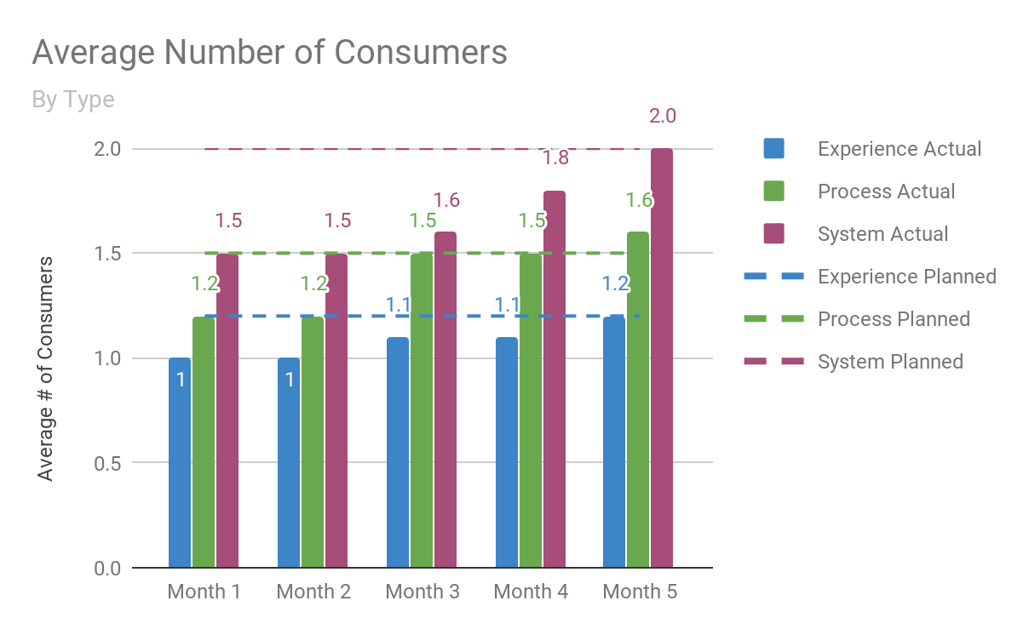
Average Number of Consumers
Planned vs. Actual
Measurement Goal
Meets Expectations | Actual >= (Planned - 10%)
Exceeds Expectations | Actual > Planned

Slide 15
Number of Consumers

Slide 16
Number of Consumers
Description: This metrics displays the top 10 APIs ranked on total number of consumers in the Production environment.
Name | Description/Calculation | Format | Source
Number of Consumers (#C) | The number of consumers who have requested access to the API and been approved in the Production environment. | Integer | Anypoint Platform APIs

Slide 17
Number of Consumers
API | Number of Consumers
Exception Routing System API | 25
AD Authentication System API | 22
Audit System API | 16
Workday Employees System API | 8
Salesforce Accounts System API | 8
ServiceNow System API | 8
CMDB System API | 5
Account DB System API | 5
Customer MDM Data API | 4
Account Update Process API | 3

Slide 18
Asset Availability & Satisfaction
C4E Metrics

Slide 19
C4E Metrics - Asset Availability & Satisfaction
Asset Availability & Satisfaction Metrics measure the overall adoption of the API-led Connectivity approach.
Feedback and consumption of existing reusable assets.
Development and delivery of new reusable assets.
Ability for API providers to incorporate feedback into updating existing reusable assets.
Providing a self-service model for API/integration consumers.
Potential Asset Availability & Satisfaction Metrics
Overall number of assets available in Exchange or the C4E Central Repository.
Provides insight on growing portfolio of integration assets for reuse.
Number of assets delivered per business group.
Total number of reusable assets provided by each business group.
Overall satisfaction of asset by type.
Asset ratings (typically a 1-5 scale) for assets by type (APIs, Standards, Best Practices, Connectors).

Slide 20
Asset Availability & Satisfaction
C4E Metric Examples

Slide 21
Number of Exchange Assets

Slide 22
Number of Exchange Assets
By Type
Description: This metric provides the number of assets in Exchange by type. This metric captures the total number of Exchange assets by type for the organization and provides insight on growing portfolio of integration assets for reuse.
Name | Description/Calculation | Format | Source
Examples | Total number of assets that have been created in Exchange of type example. | Integer | Exchange APIs
Templates | Total number of assets that have been created in Exchange of type template. | Integer | Exchange APIs
REST APIs | Total number of assets that have been created in Exchange of type rest-api. | Integer | Exchange APIs
SOAP APIs | Total number of assets that have been created in Exchange of type soap-api. | Integer | Exchange APIs
HTTP API | Total number of assets that have been created in Exchange of type http-api. | Integer | Exchange APIs
Connectors | Total number of assets that have been created in Exchange of type connector. | Integer | Exchange APIs
Custom | Total number of assets that have been created in Exchange of type custom. | Integer | Exchange APIs
Notes:
example, template, connector, rest-api, soap-api

Slide 23
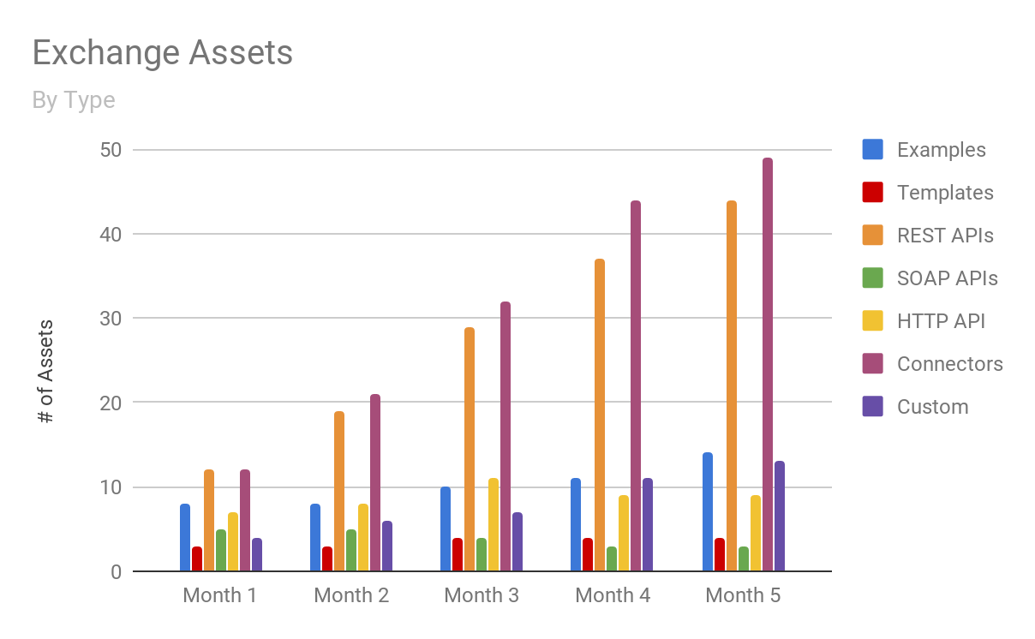
Number of Exchange Assets
By Type
Measurement Goal
Meets Expectations | Current Month’s Total of Assets >= Last Month’s Total of Assets
Above Expectations | Current Month’s Total of Assets >= Last Month’s Total of Assets * 1.25

Slide 24
Overall Asset Satisfaction

Slide 25
Overall Asset Satisfaction
By Type
Description: This metric measures the rating of all assets currently offered in Exchange by asset type. The metric demonstrates the value of the assets currently housed in Exchange by asset type.
Name | Description/Calculation | Format | Source
Rating | The current rating of each asset, measured between 0 (low-value asset) to 5 (high-value asset). | Integer | N/A
< 2.5 | Number of assets (by type) whose rating is below 2.5 | Integer | Exchange APIs
2.5 - 3.5 | Number of assets (by type) whose rating is between 2.5 and 3.5. | Integer | Exchange APIs
3.5 - 4.0 | Number of assets (by type) whose rating is between 3.5 and 4.0. | Integer | Exchange APIs
4.0 - 4.5 | Number of assets (by type) whose rating is between 4.0 and 4.5. | Integer | Exchange APIs
4.5 < | Number of assets (by type) whose rating is above 4.5. | Integer | Exchange APIs

Slide 26
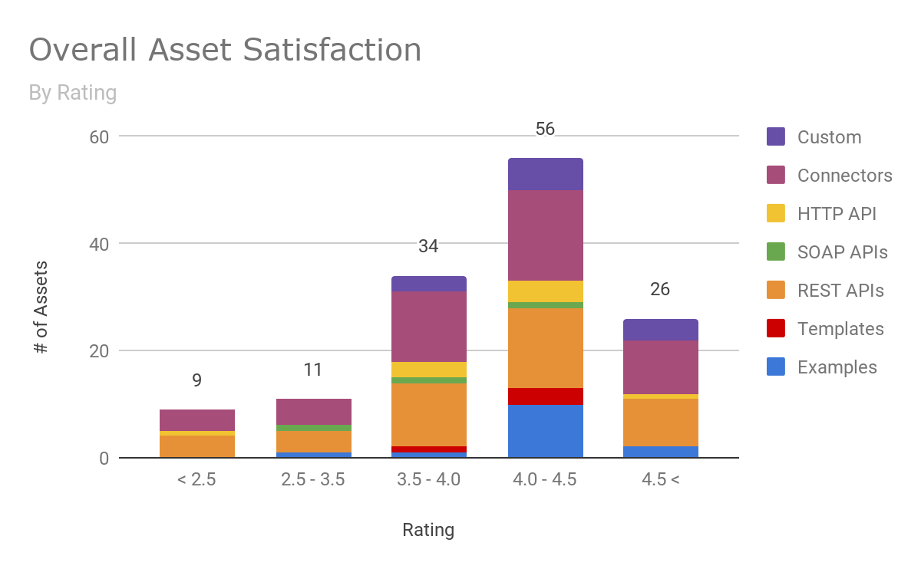
Overall Asset Satisfaction
By Type

Slide 27
Evangelism
C4E Metrics

Slide 28
C4E Metrics - Evangelism
Evangelizing the C4E encourages developers and architects to operate in a self-service way which minimizes delivery bottlenecks.
Developers and Architects can access assets (e.g. connectors, APIs, best practices, templates, integration patterns, solution designs, common services) directly without interruption.
Potential Evangelism Metrics
Number of evangelism events by type.
Measures the amount of developer engagement (presentations, demos) performed on a periodic basis.
Average attendance of events by type.
Identifies the types on engagements that are most effective for the organization.
Event attendees per business group.
Identifies the business groups that are leading the adoption of API-led Connectivity.
Number of employees on C4E newsletter distribution list.
Gauges the interest in C4E activities and events.

Slide 29
Employee Onboarding
C4E Metrics

Slide 30
C4E Metrics - Employee Onboarding
Employee onboarding processes ensures that MuleSoft developers and architects are enabled and productive in short order.
Resources that have appropriate training are more productive when developing applications and deliver higher quality work.
Resources that are knowledgeable of existing reusable APIs and integrations are less prone to building point-to-point solutions from scratch.
Potential Employee Onboarding Metrics
Number of productive MuleSoft developers and architects.
Measures the growing capability to successfully deliver MuleSoft projects within the organization.
Number of resources currently being onboarded.
Measures the organization’s interest in growing a MuleSoft capability.
Length of time taken for onboarding.
Evaluates the number of hours required to produce a productive developer, architect or MuleSoft support engineer.

Slide 31
Governance
C4E Metrics

Slide 32
C4E Metrics - Governance
Delivering solutions consistently and repeatedly is a key measure to improving delivery times and increasing application quality.
APIs rely on consistent standards for data retrieval/updates and specific data format standards for easier manipulation and transformation.
Potential Governance Metrics
Number of systems that are accessible by managed APIs.
Calculates the number of systems that can expose data through APIs.
Percentage of common data (e.g. customer/order) that is accessed via managed APIs.
Calculates the number of critical data objects that are available through APIs.
Number of point-to-point integrations that have been retired/eliminated.
Tracks the reduction of technical debt incurred by the creation of one-time ad-hoc integrations.
Number of batch integrations that have been retired/eliminated.
Tracks the replacement of long-running batch processes with near-realtime APIs so that the business has an up-to-date view on performance.

Slide 33
Thank You

